Slide 1
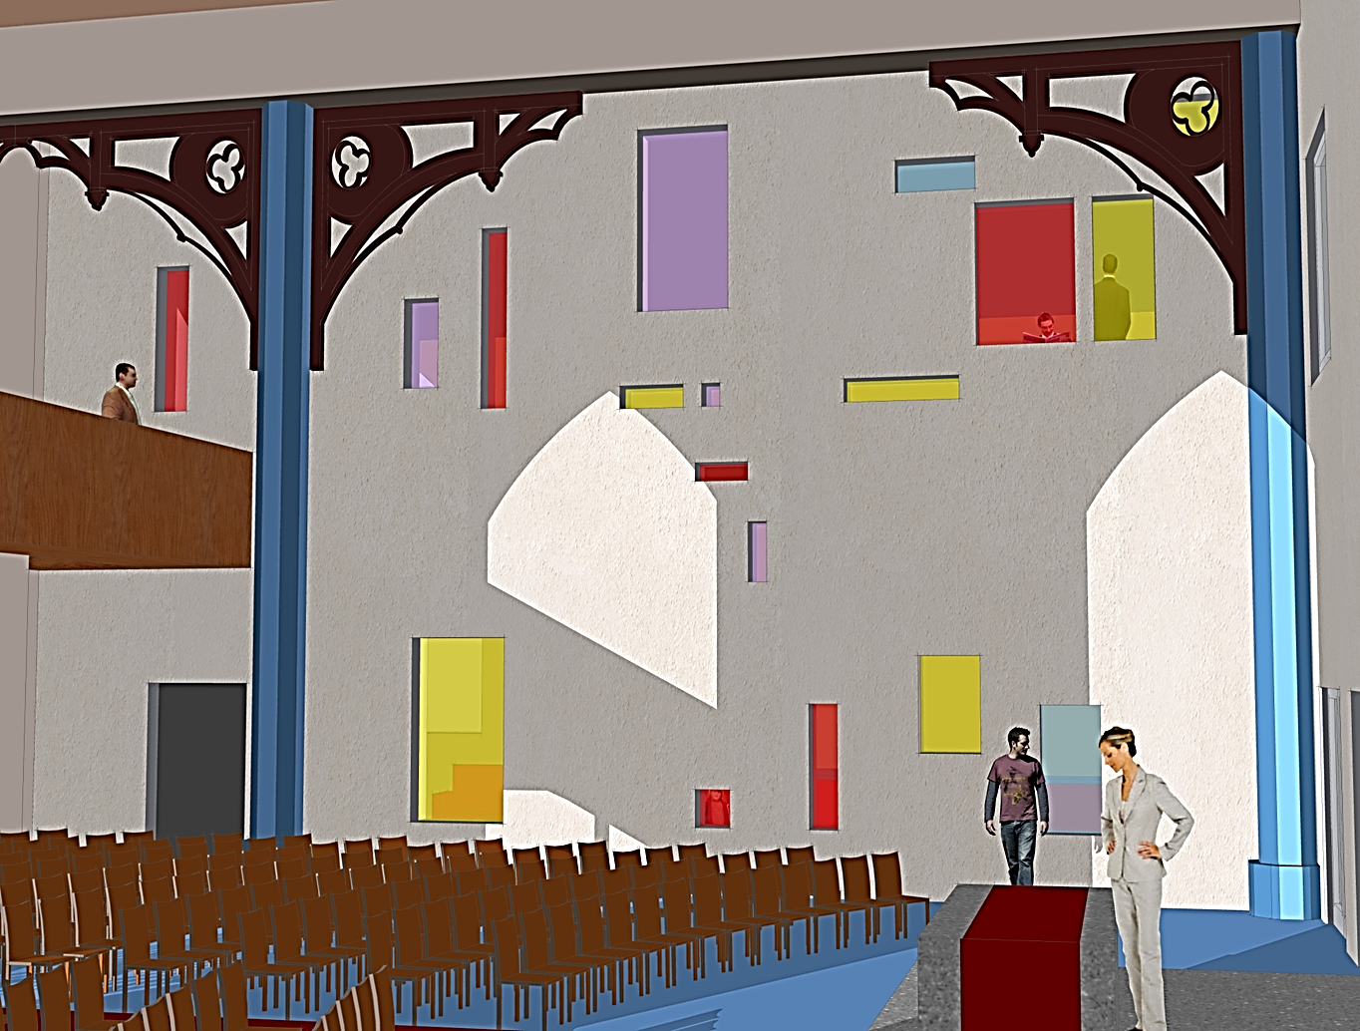
Forfar East & Old Parish Church
Brian Smith, Wellwood Leslie; Graham Kerr , John Duguid Partnership- 26 June 2013
PROPOSED HOUSING DEVELOPMENT—TWEEDBRIDGE COURT—PEEBLES

Slide 2
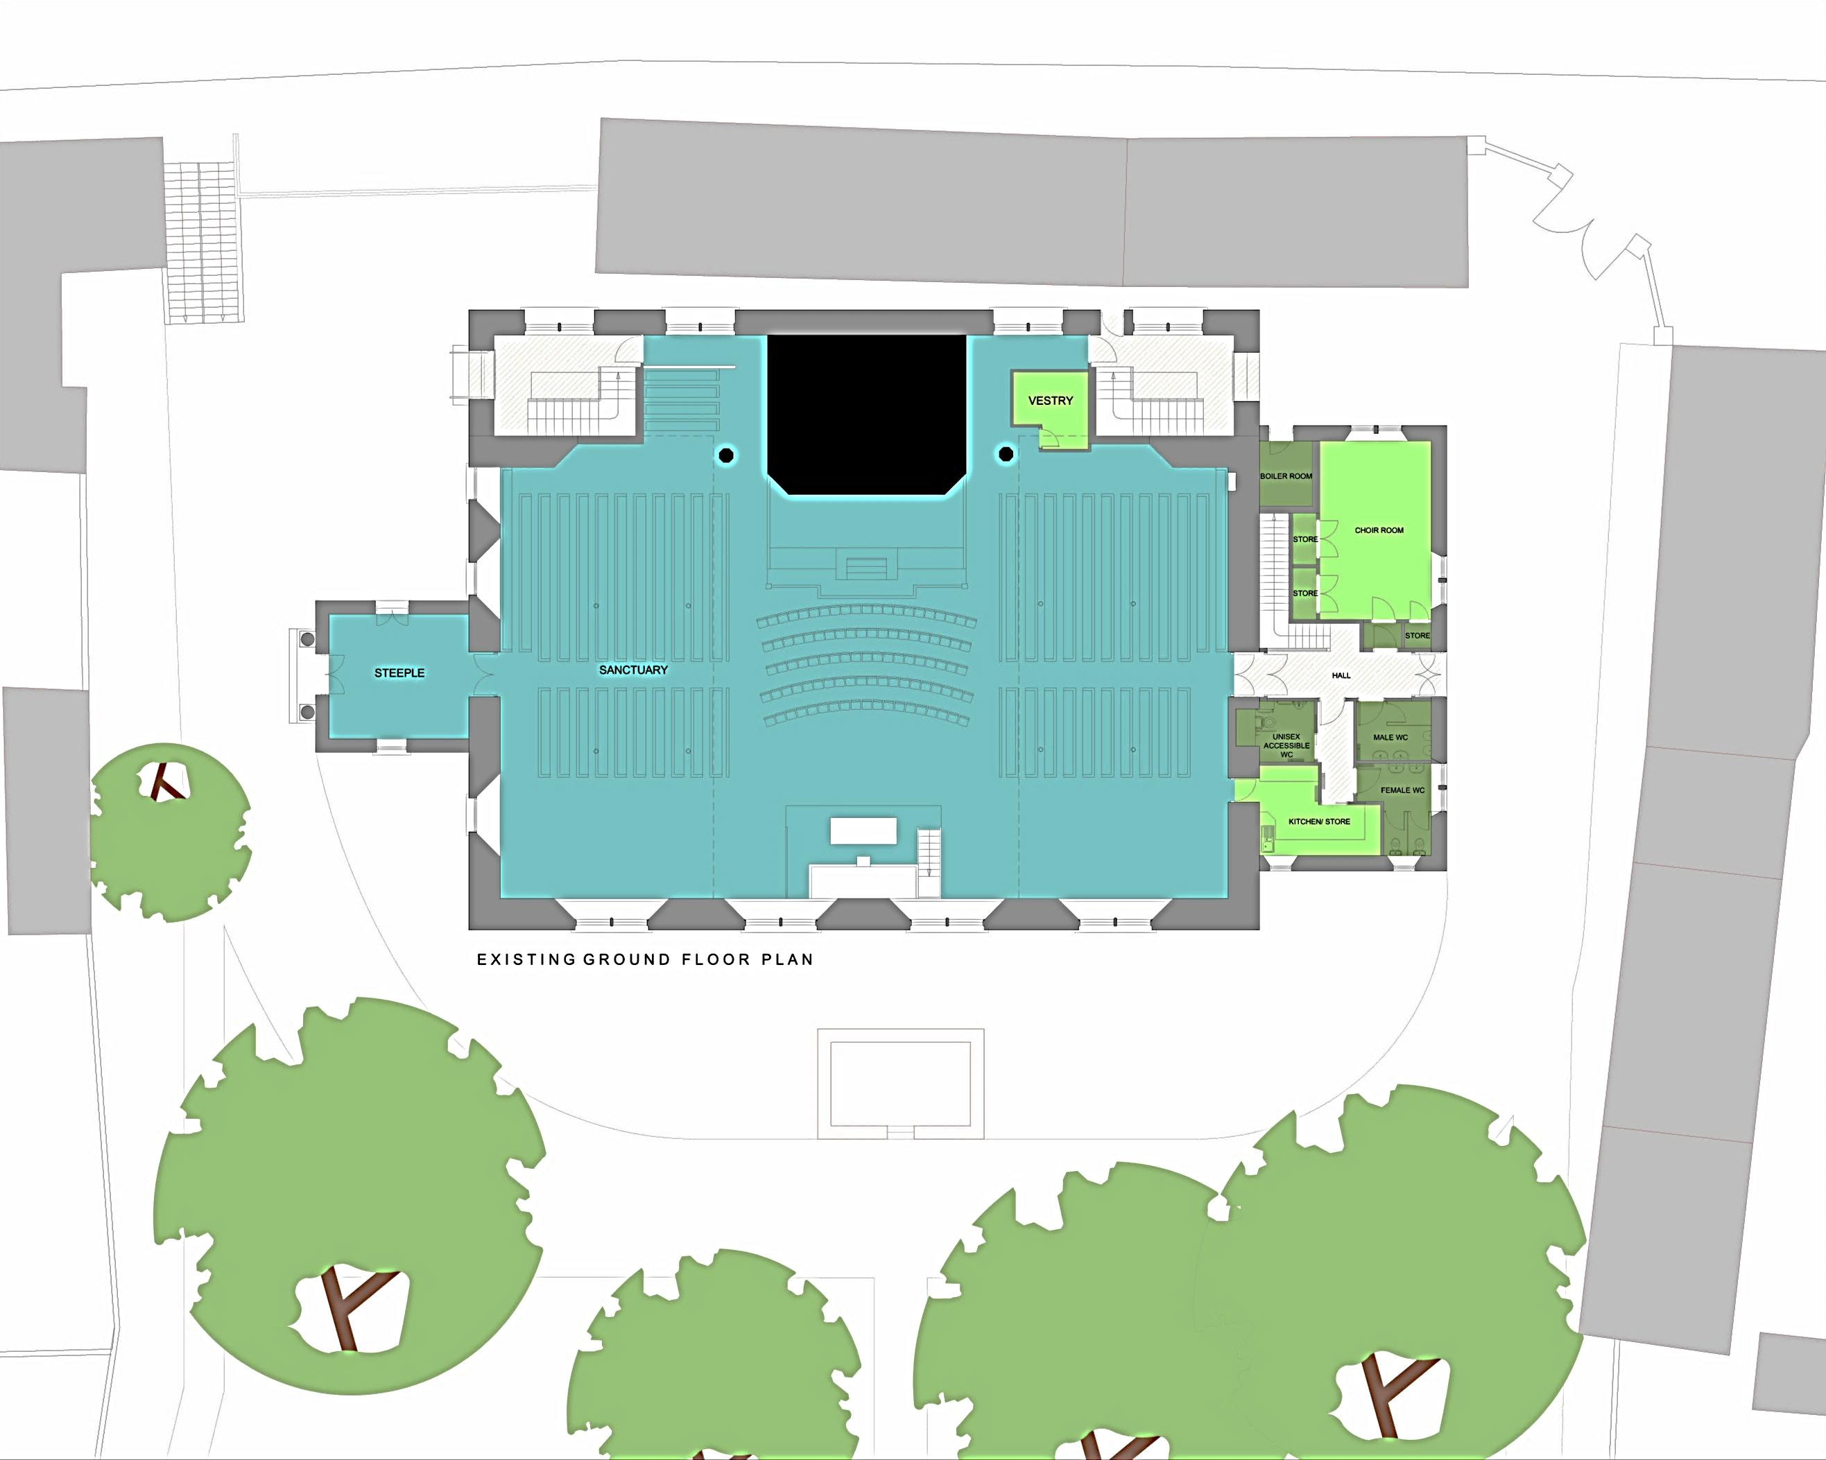
Existing Site Plan
PROPOSED HOUSING DEVELOPMENT—TWEEDBRIDGE COURT—PEEBLES

Slide 3
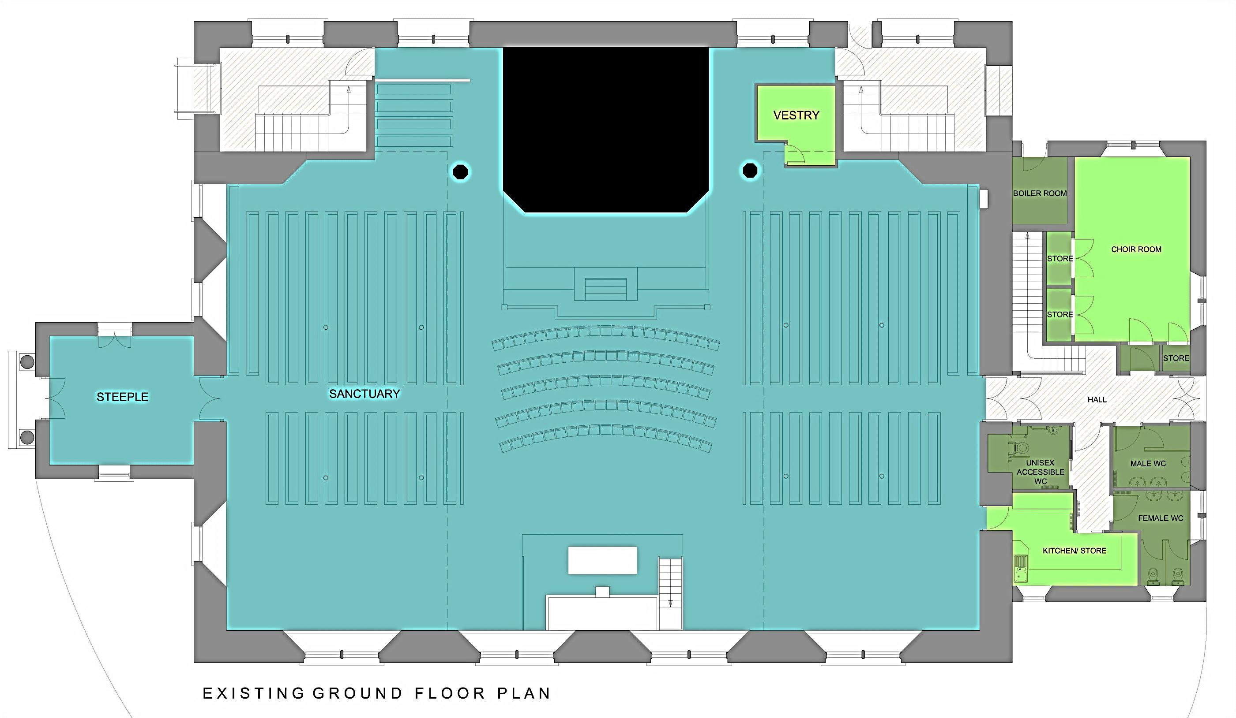
Existing Ground Floor Plan
PROPOSED HOUSING DEVELOPMENT—TWEEDBRIDGE COURT—PEEBLES

Slide 4
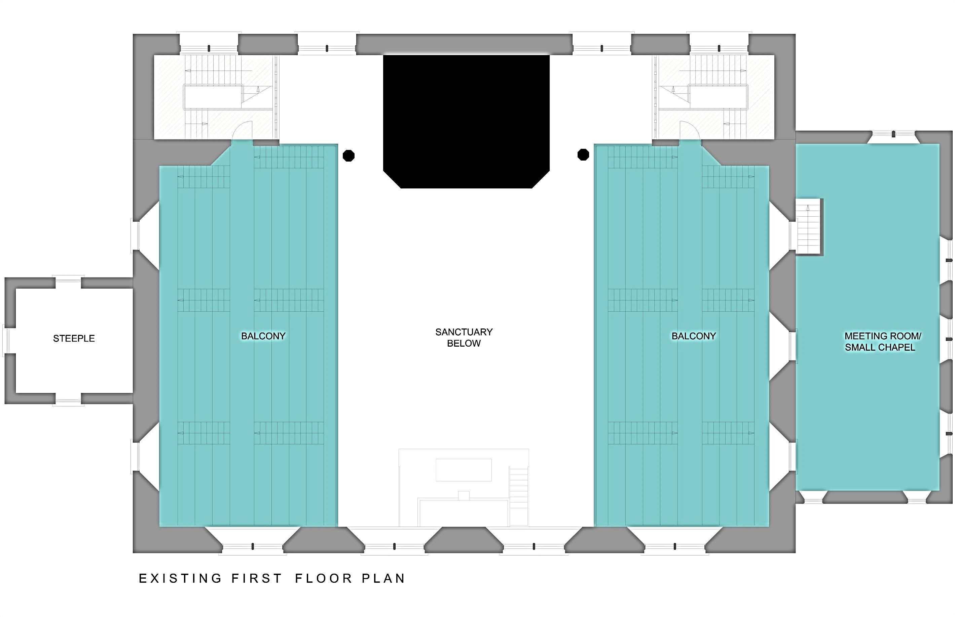
Existing First Floor Plan
PROPOSED HOUSING DEVELOPMENT—TWEEDBRIDGE COURT—PEEBLES

Slide 5
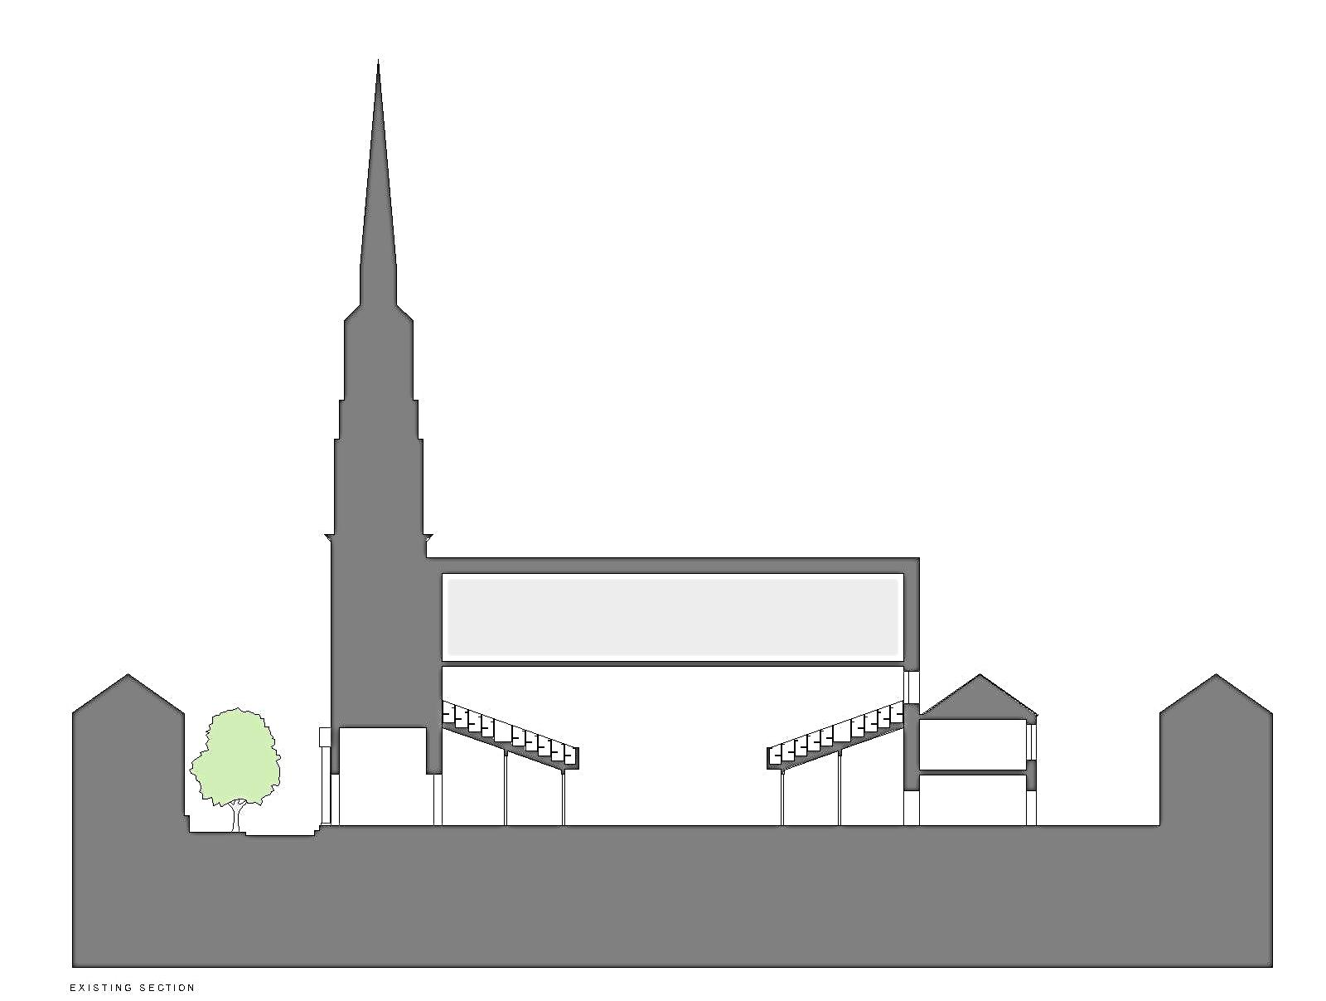
Existing Section
PROPOSED HOUSING DEVELOPMENT—TWEEDBRIDGE COURT—PEEBLES

Slide 6
Brief Requirements
To provide a building that will accommodate a range of community and visitor facilities within the existing envelope of Forfar East and Old Parish Church.
Including-
  Limited external works to formalise ad-hoc car parking arrangements
  Ground floor alterations to form-
    New entrance foyer, reception and exhibition space
    New Vestry, with minister’s changing and toilet facilities
Brief Requirements
PROPOSED HOUSING DEVELOPMENT—TWEEDBRIDGE COURT—PEEBLES

Slide 7
Reduced and re-orientated Sanctuary space to seat 600-800 people-
        Removal of existing organ and replacement with new electronic organ
        Removal of fixed pews and replacement with flexible seating
        Chancel area to accommodate:
          Communion table
          Font
          Reading lectern
          Space for music group
        Space for an organ console and audio-visual equipment
        New audio-visual system
    Rationalised circulation routes
    Social space for community/congregational use
    Feature wall to accommodate existing tablets, scrolls and community art
    New lift
Brief Requirements (continued)
PROPOSED HOUSING DEVELOPMENT—TWEEDBRIDGE COURT—PEEBLES

Slide 8
First floor alterations to form-
    Refurbished Small Chapel to accommodate 30 people, a keyboard and audio-visual equipment
    Toilets
    Storage
    Multi-function space
    Removal of east gallery to accommodate altered Sanctuary space
    Interconnecting stair between Session House and main building
    Exhibition/meeting spaces above reception space
    Limited fabric survey to ascertain extent of any necessary structural works
  Review and possible upgrading of small power distribution system
  Review and possible upgrading of domestic hot water, heating and ventilation systems
Brief Requirements (continued)
PROPOSED HOUSING DEVELOPMENT—TWEEDBRIDGE COURT—PEEBLES

Slide 9
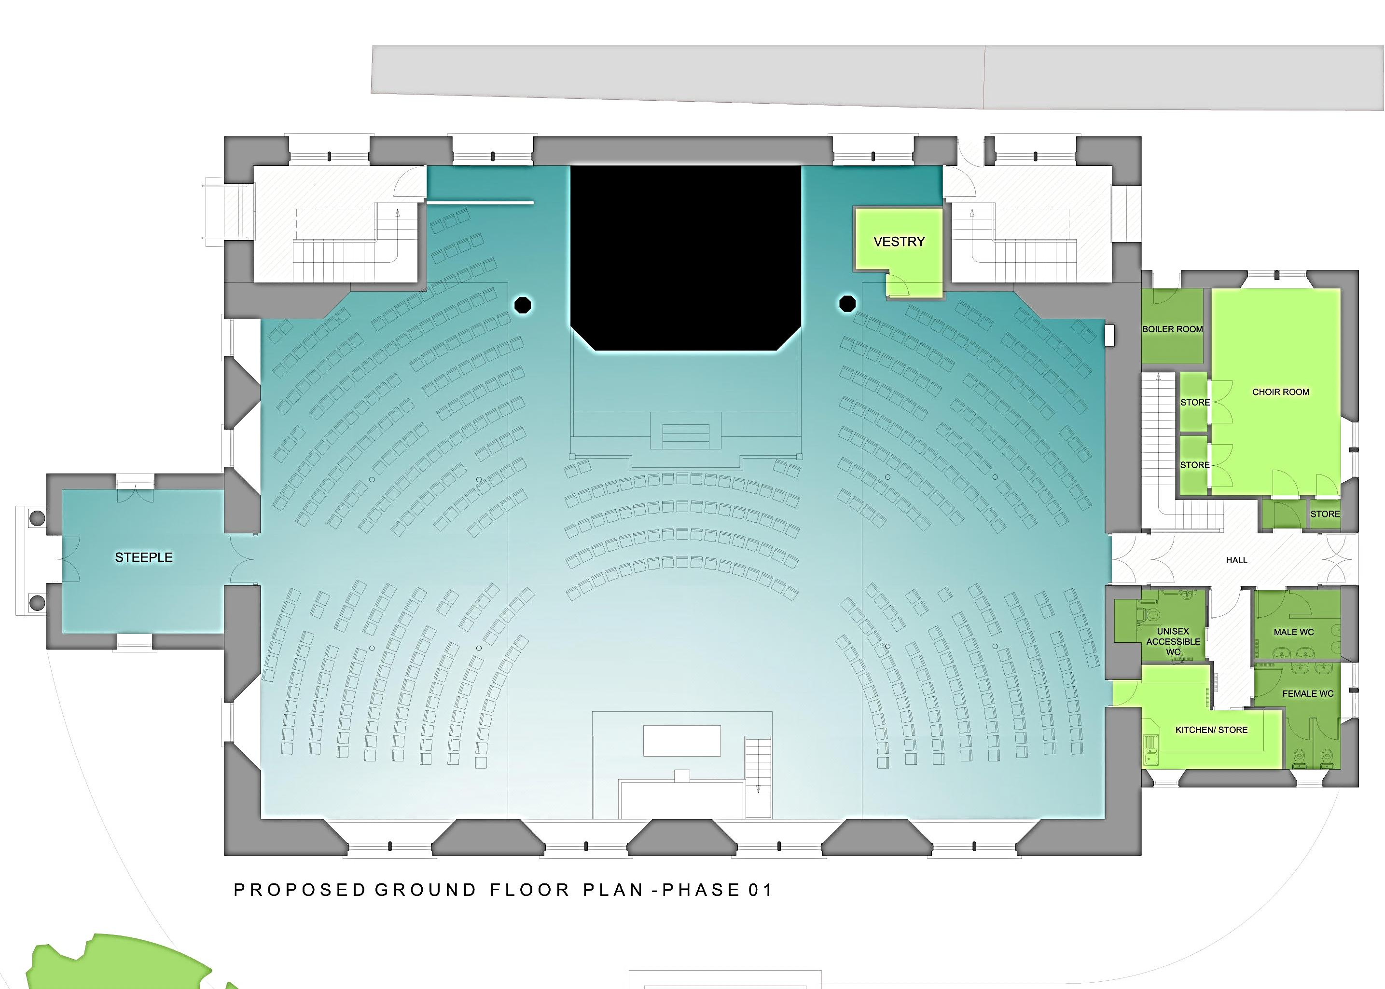
Proposed Phase 1 Development

Slide 10
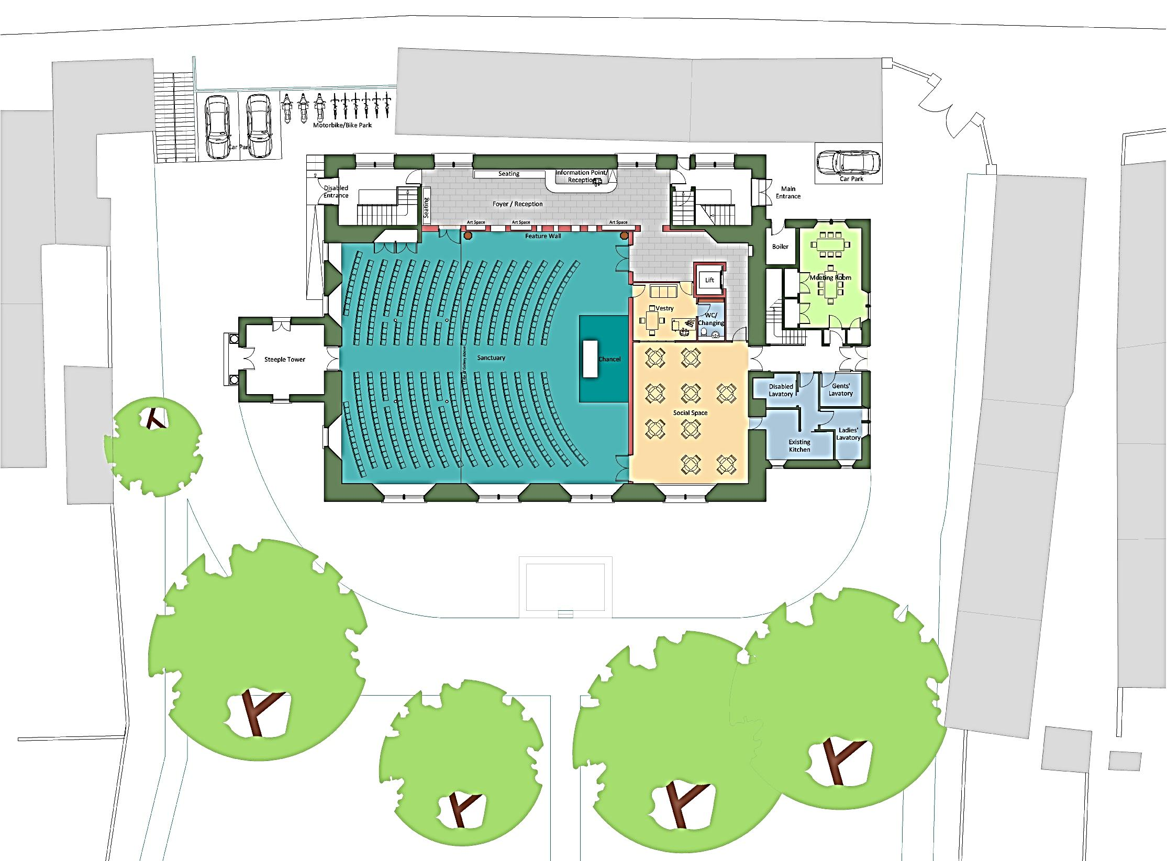
Proposed Site Plan

