Slide 1
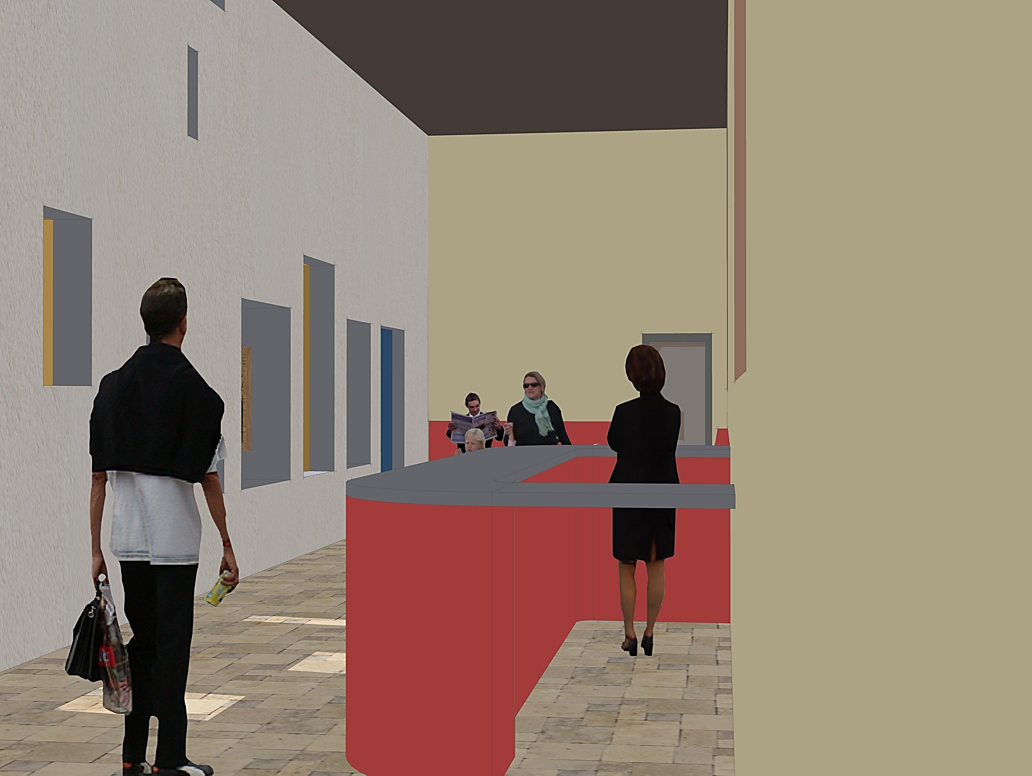
Foyer/Reception looking west
PROPOSED HOUSING DEVELOPMENT—TWEEDBRIDGE COURT—PEEBLES

Slide 2
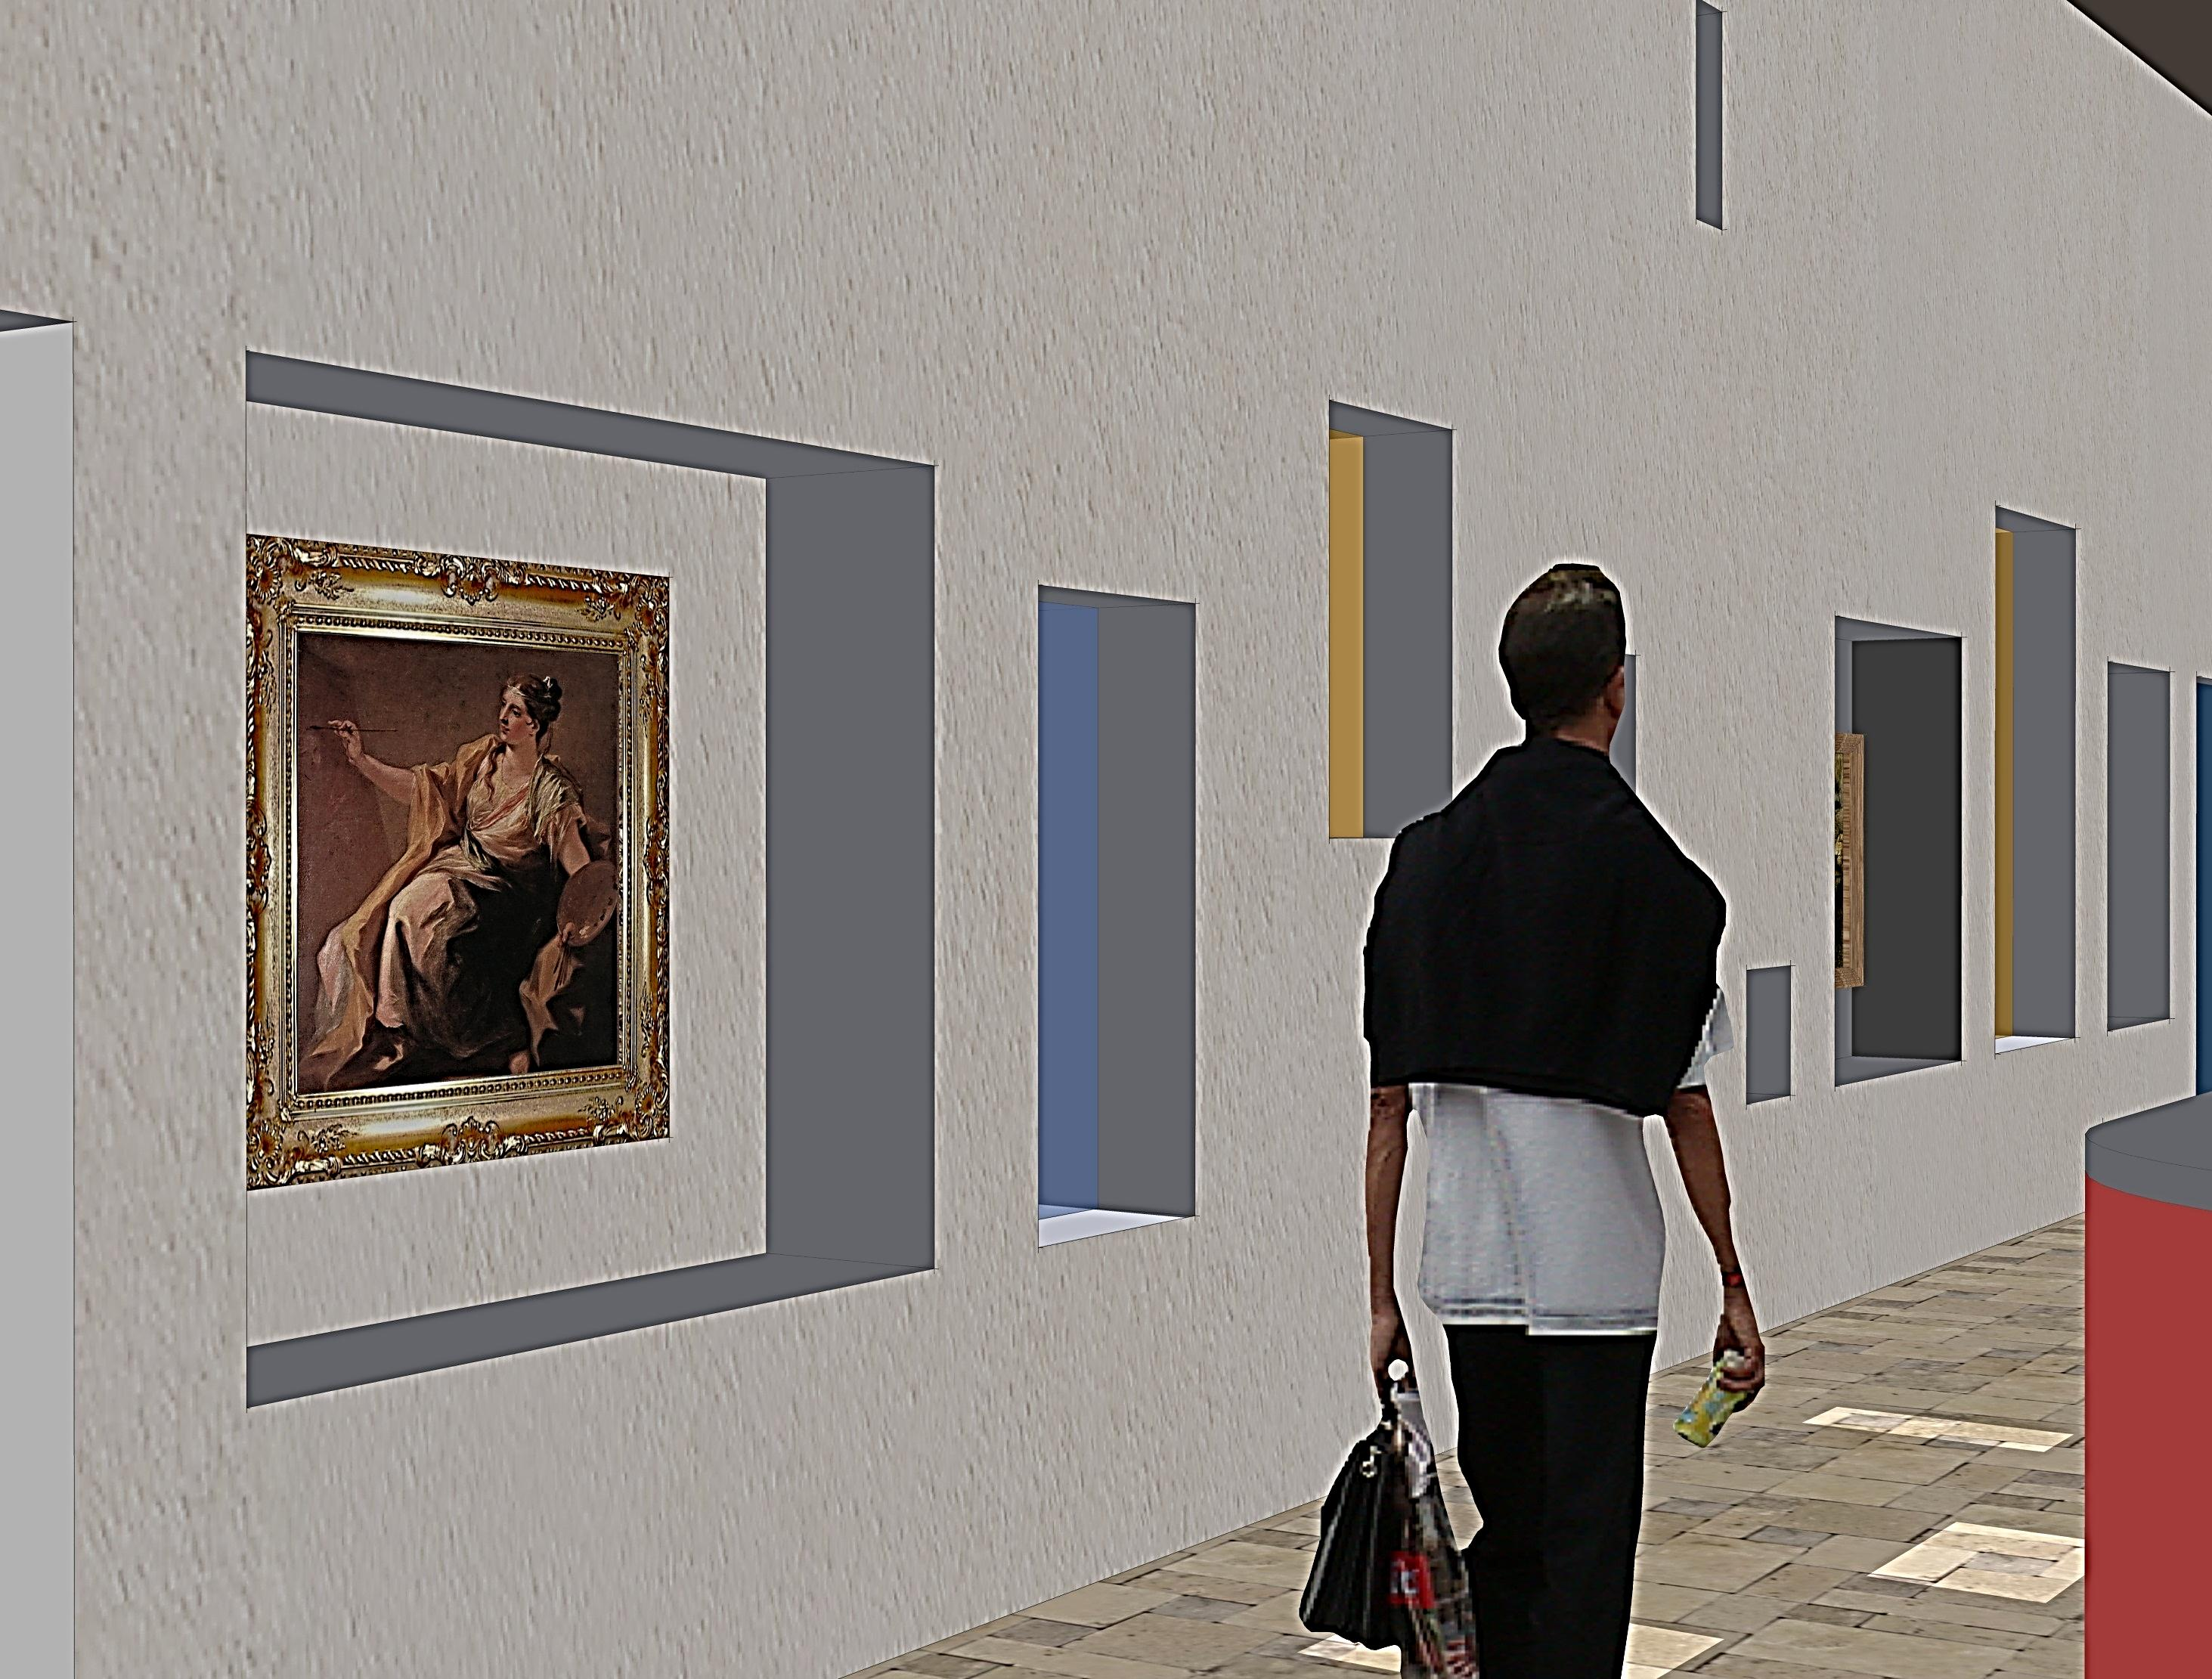
Foyer/Reception looking south
PROPOSED HOUSING DEVELOPMENT—TWEEDBRIDGE COURT—PEEBLES

Slide 3
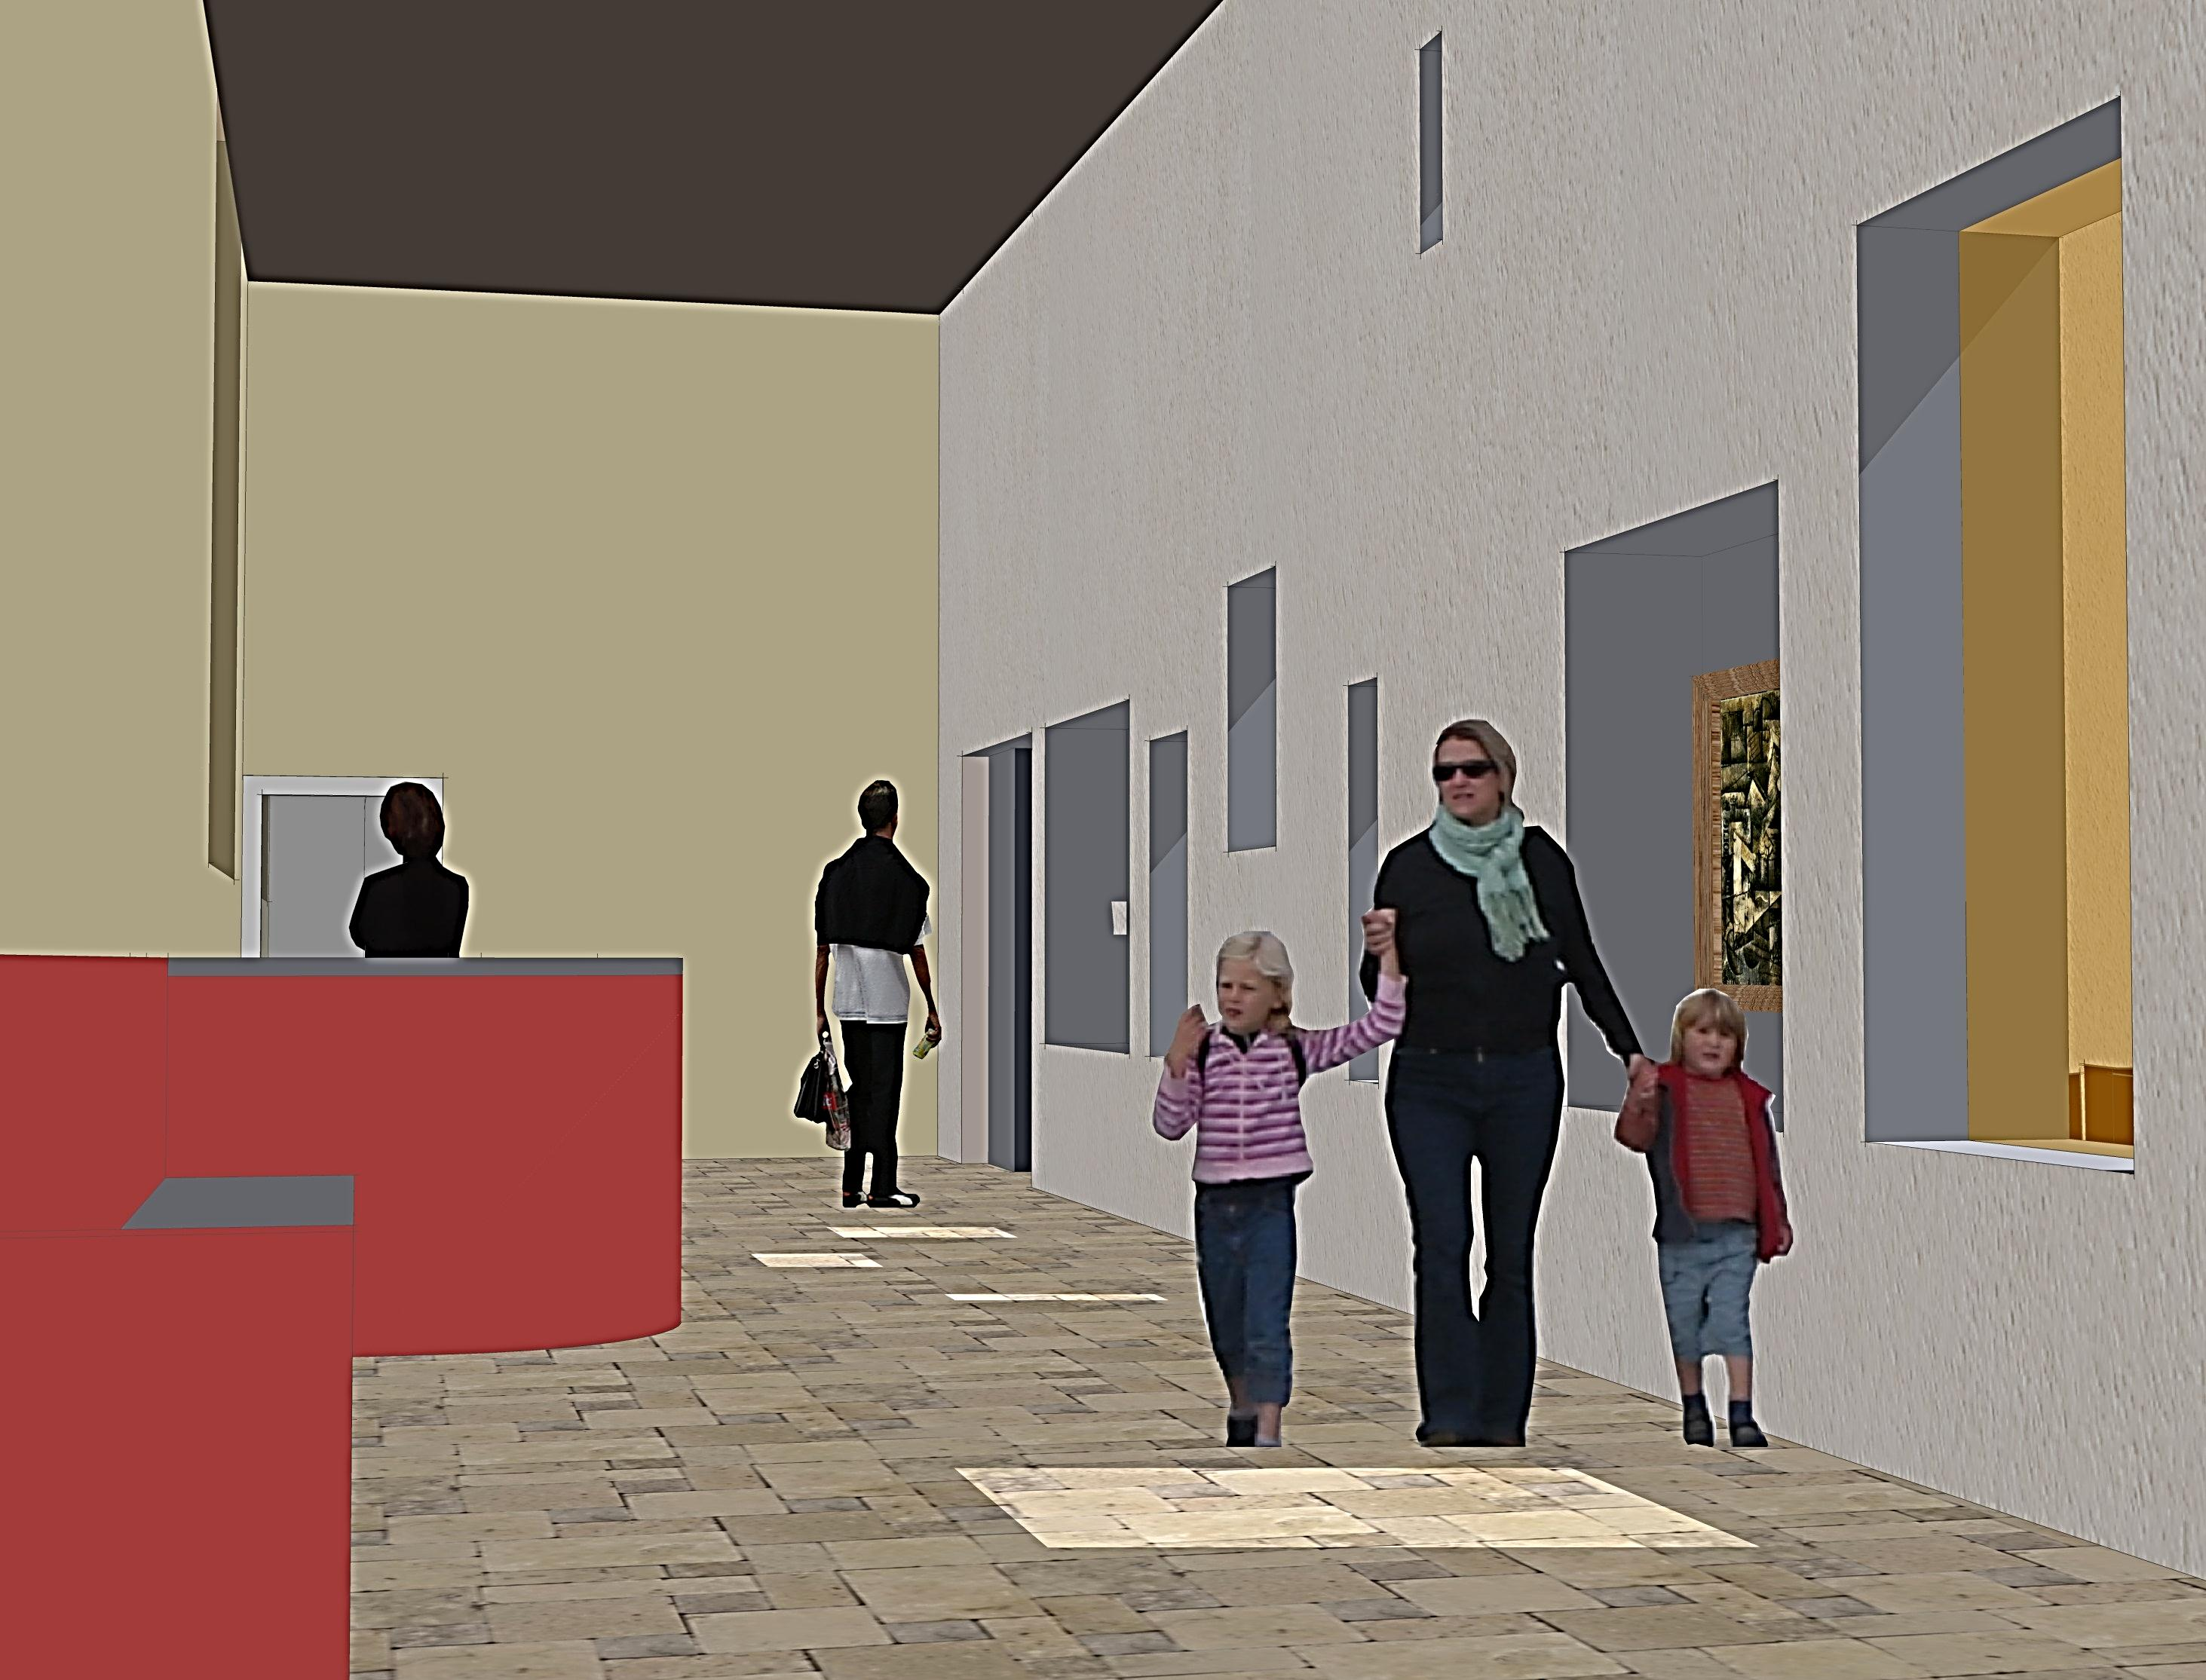
Foyer/Reception looking east
PROPOSED HOUSING DEVELOPMENT—TWEEDBRIDGE COURT—PEEBLES

Slide 4
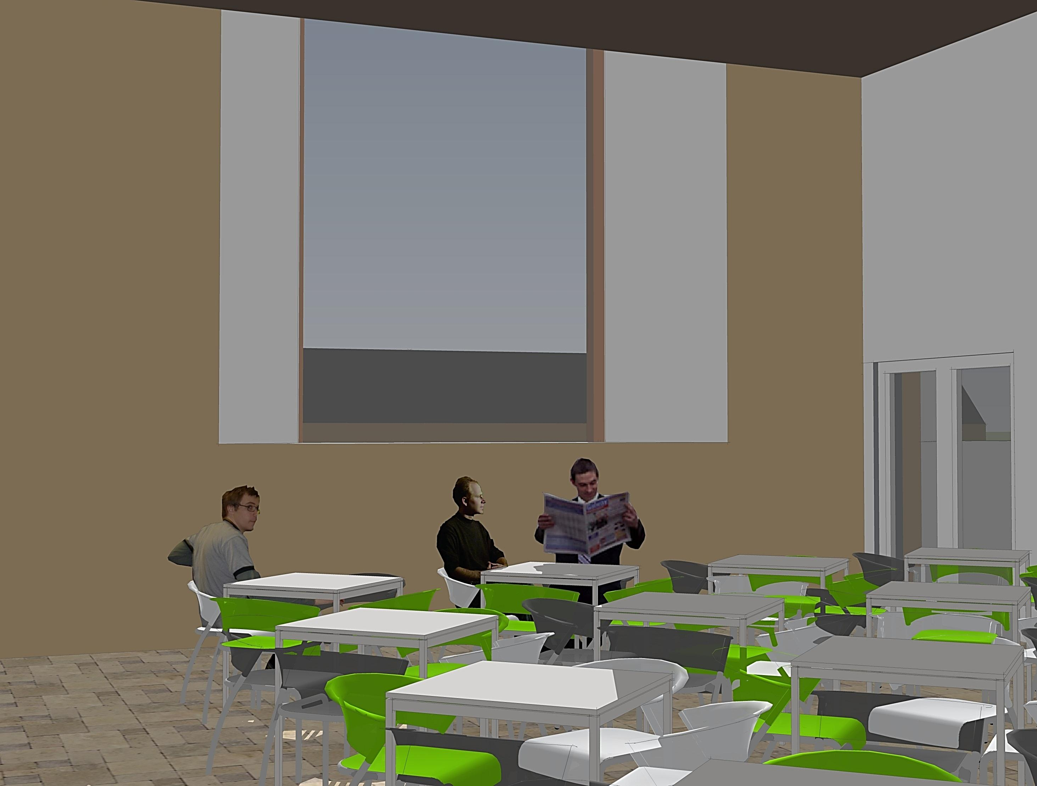
Social Space

Slide 5
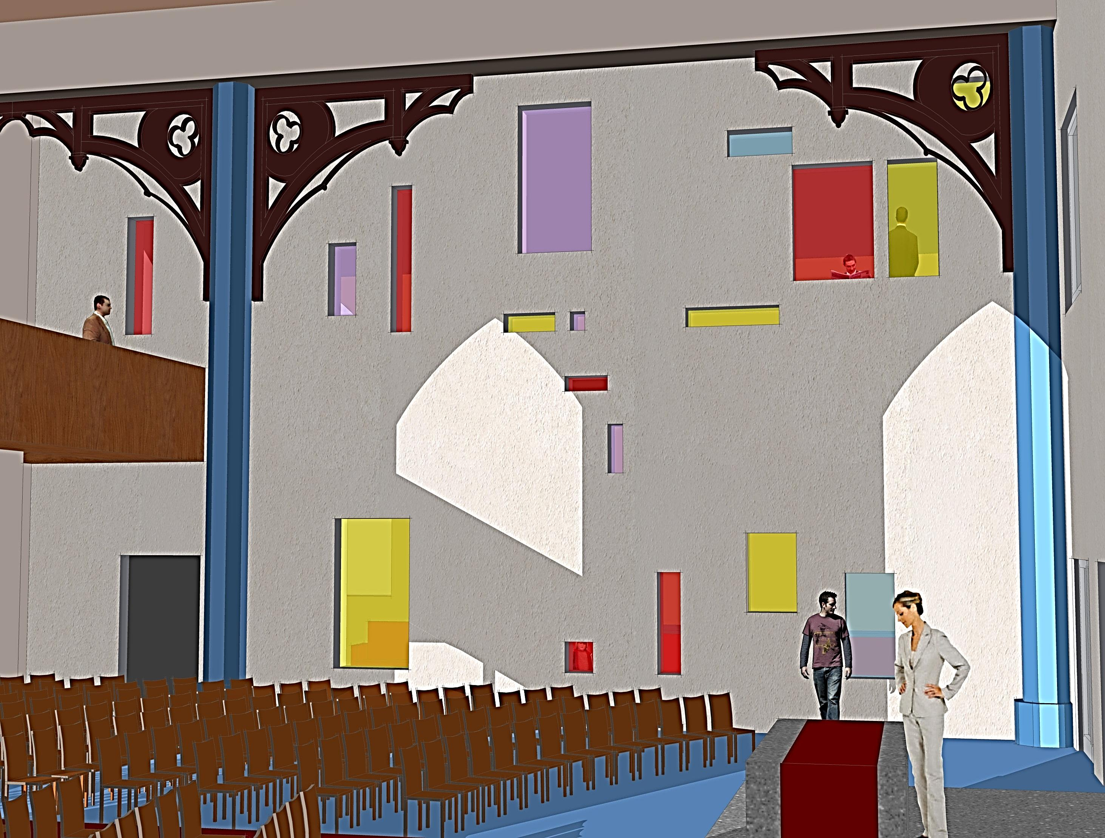
Sanctuary looking north

Slide 6
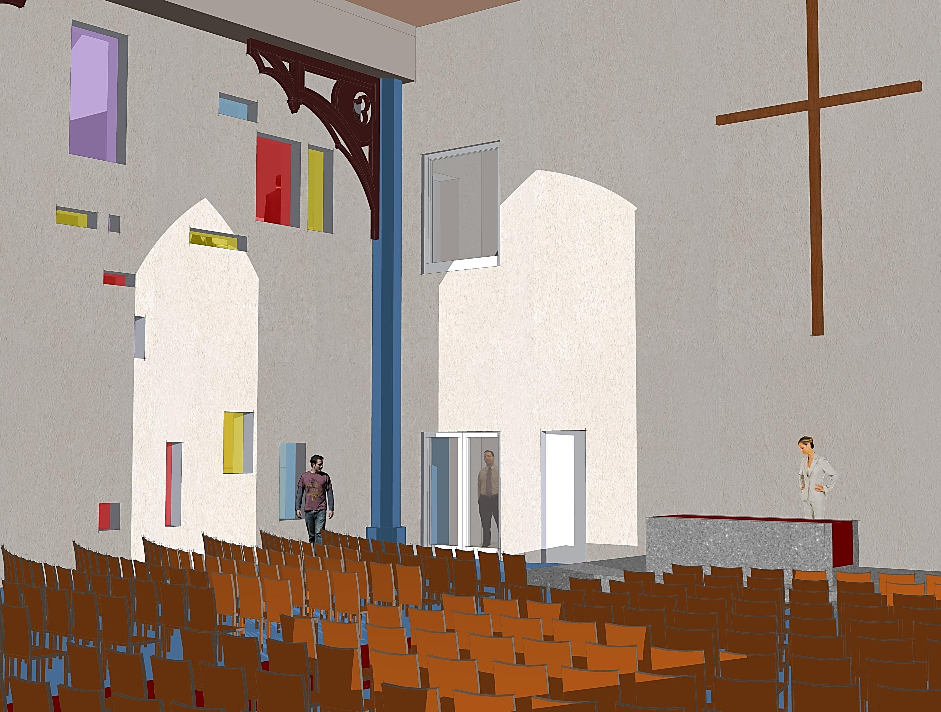
Sanctuary looking east

Slide 7
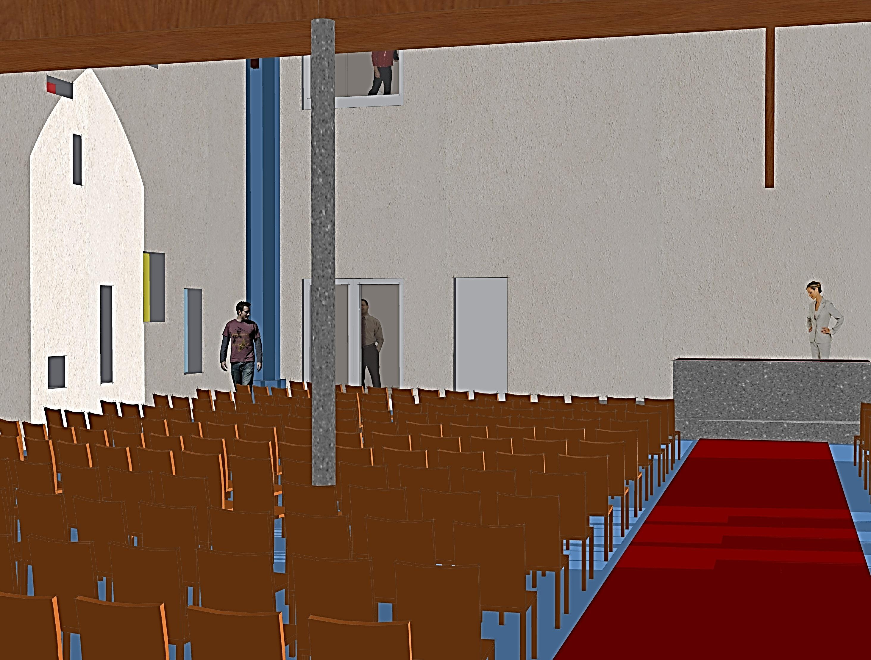
Sanctuary looking east

Slide 8
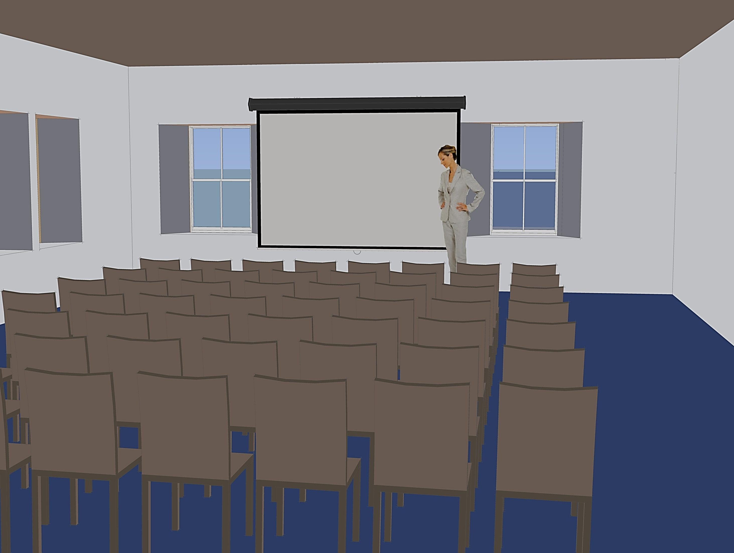
Small Chapel

Slide 9
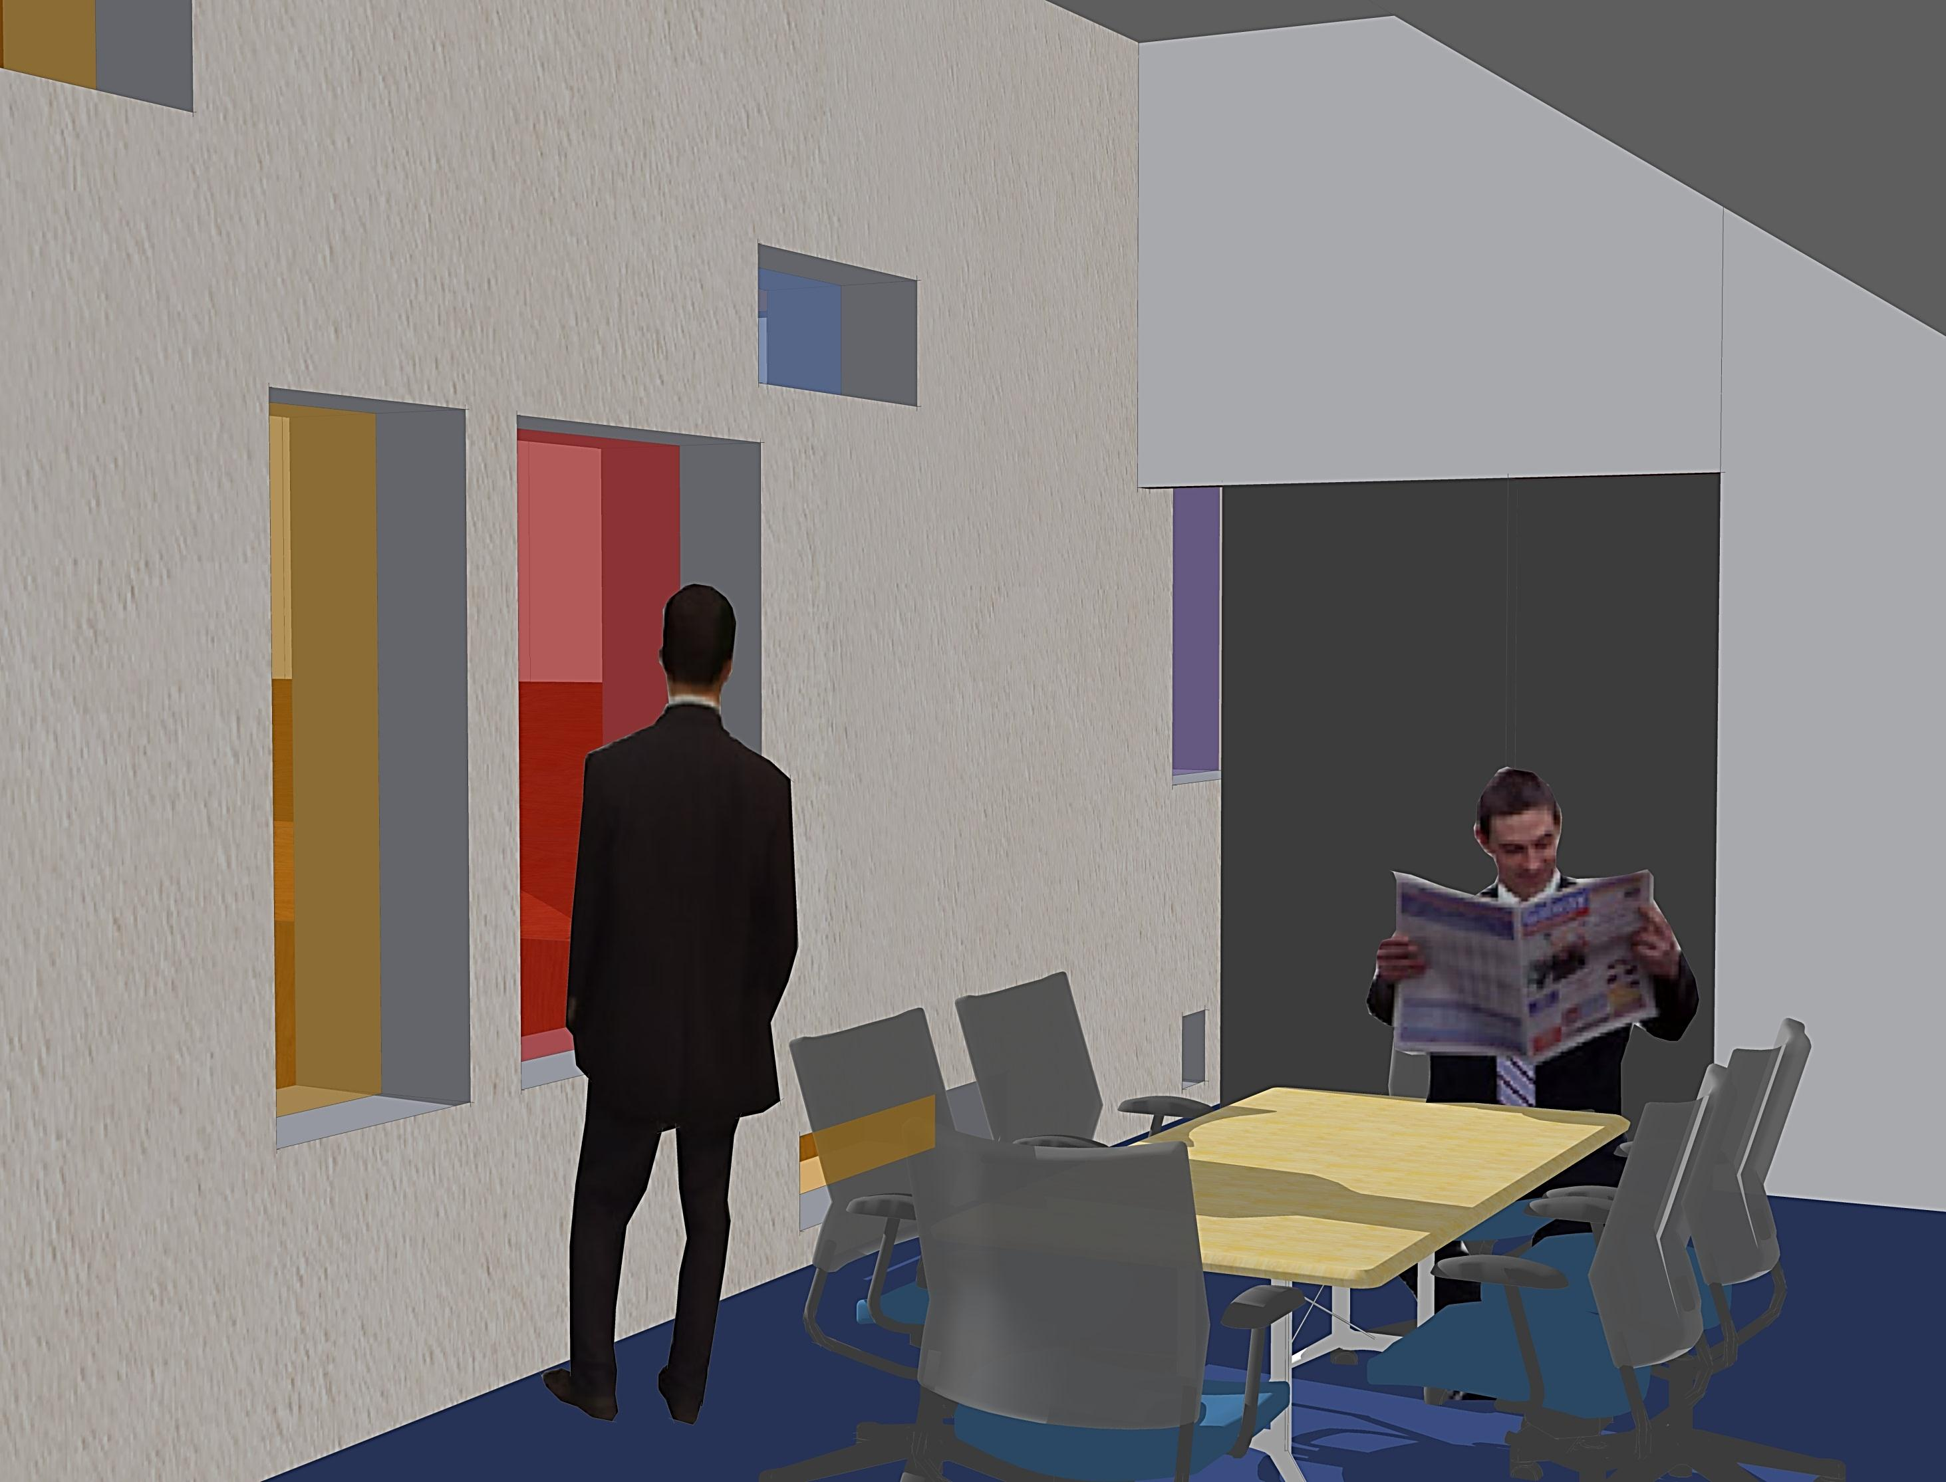
Meeting/Exhibition Space

Slide 10
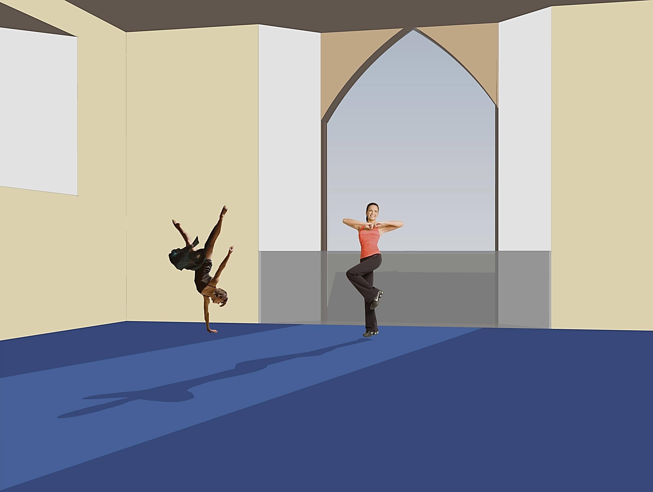
Multi-Purpose Room

